Slide 1


Slide 2
Analyzing Personality through Social Media Profile Picture Choice
Anuj Khasgiwala

Slide 3
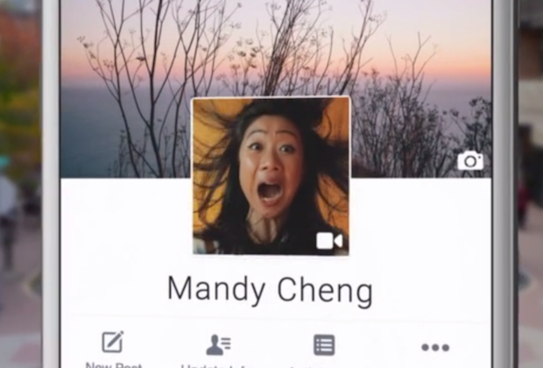
Motivation
Social media images portrays personality
Audience: Twitter users
Dataset: 66000 users
How: using tweets
Interpretation: analysis on aesthetic and facial features and control for demographic variation in image features and personality

Slide 4
Introduction
Freedom to speak or convey
Presentation depends on psychological traits and represent persona
Previous work on user traits(age, gender, occupation etc.)
Choice of Photos are type of behavior associated at least in part with personality expressed by five factor model
Digman Big Five – consisting of openness to experience, conscientiousness, extraversion, agreeableness and neuroticism

Slide 5
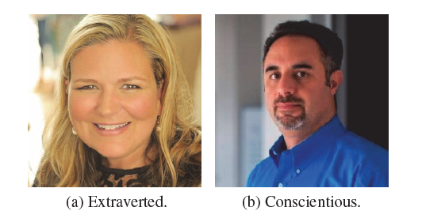
Relation between Personality and Picture

Slide 6
Relation between Personality and Picture
Extravert
Enjoy interacting
High group visibility
Energetic
Use picture involving other people or the once that express more positive emotions
may be more inclined to choose unconventional images and poses, as a general inclination of this type of people for art and novelty.
Conscientiousness
More orderly
Prefer planned behavior
Use frontal photography of themselves
Neuroticism is associated with negative emotions, which could also be reflected through users choices of profile images

Slide 7
Features
Colors, aesthetics, facial presentation, emotions
Compare features with Big Five model.
Previous studies conclusion
Personality traits are predictable from images, demonstrating correlation between personality and profile picture.
features of the models provide no interpretability and thus are not useful for psychologists who wish to understand the underlying correlations and generate hypotheses for further testing.
Data set was very limited size and user diversity

Slide 8
Related Work
Most studies in psychology focused on facial expressions as people frequently use facial characteristics for personality attributions, while some studies consider pose of person
Due to recent advancement in computer science, automatic personality detection became important research topic.
Personality influences a wide range of behaviors, many of which can be directly observed through social media usage.
Most computer vision work focus on object, for personality subject of interest is person face.
computer vision framework for object recognition relies on thousands of low level features either pre-determined or, morerecently, automatically extracted by deep neural networks
Celli Bruni and Lepri(2014) used 100 facebook user with self assessed personalities and interaction styles

Slide 9
Related Work contd.
They used bag-of-visual-words features defined on local SIFT (Lowe 2004) features and combined different machine learning algorithms to test the effectiveness of classifying users as being high or low in each personality trait.
Classify personality traits with nearly 65% accuracy
To interpret the results, they performed clustering on correctly classified images from each personality trait to find the most important characteristics of each personality trait and observed that extroverted and emotionally stable people tend to have pictures in which they are smiling or appear with other people.
Al Moubayed, Noura and Vazquez-Alvarez, Yolanda and McKay, Alex and Vinciarelli, Alessandro (2014) used the FERET corpus consisting of 829 individuals whose personality was assessed by 11 independent judges. They used the first 103 eigenfaces as features for classification and reported around 70% accuracy in predicting personalities being above or below the median.

Slide 10
Data
Used 2 twitter datasets differing in size and set of available user traits.
TwitterText:
66502 twitter users(31307 M, 35195 F)
Labelled by linking twitter account with account on other network where gender information was available
For each user collected 3200 most recent tweets using REST leading to 104,500,740 tweets
TwitterSurvey:
Contains 434 twitter users whose Big Five personality scores were computed
Users self reported genders.
All images were collected same day for all accounts in both data set

Slide 11
Text Analysis
used posted tweets from an account as a different modality compared to images in order to predict user attributes and demographics.
Text-based prediction methods have been successfully used to predict a wide range of traits including age, gender, political orientation, location, impact, income, occupation, mental illnesses and personality.
Tokenize posts and filtered for English using Langid tool.
Aggregate all users posts and use “state-of-the-art” text prediction algorithms to estimate personality and age
For reliable estimates considered users with 50+ tweets
Notes:
Location was done by Prof Lee

Slide 12
Prediction outcome
Personality
Used method developed by Schwartz to assign each user scores for personality from ‘Big Five’ - extraversion, agreeableness, conscientiousness, neuroticism and openness to experience
Model was trained on large sample of around 70k fb users who have taken Big Five personality tests and shared their posts using a model using 1-3 grams and topics as features
In original validation, the model achieved a Pearson correlation of r > 0.3 predictive performance for all five traits, which is considered high correlation in psychology, especially when measuring internal states
Observed the same correlation patterns in text predictions as in the questionnaire based assessments
Age
The correlation of the outcome of the prediction model and true age, trained and tested on Facebook data, reaches .835 Pearson correlation
Notes:
Location was done by Prof Lee

Slide 13
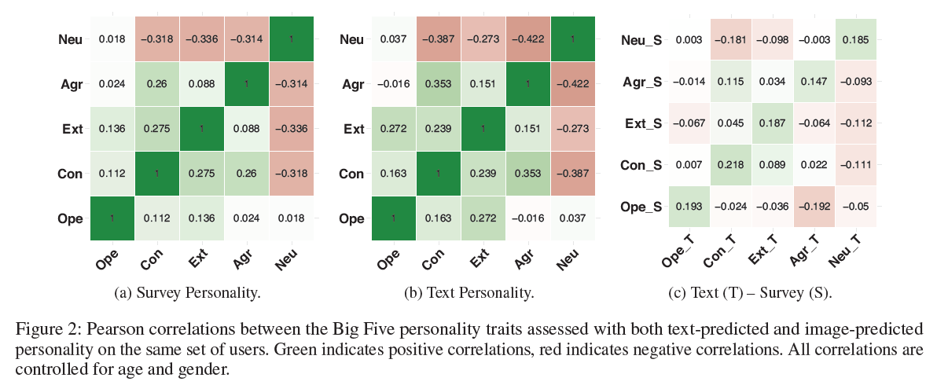

Slide 14
Image Extraction
Used public profile images as representative for a user. Although users can post other images, we focus on profile images, as the user has chosen these to represent their online persona and thus is most likely to contain important psychological cues.
to study and interpret people’s personalities from their profile pictures, stylistic characteristics rather than traditional computer vision features of the profiles are more appropriate.
Divide image features in two categories: general image features and stylistic facial features. The former contains basic color and facial information, while the later also includes facial expressions and postures extracted from the largest recognizable face from profile images.
Used two APIs based on deep learning – Face++ and EmoVu – for facial feature extraction.
Face++, which provides very accurate face recognition to indicate demographics and facial presentation. EmoVu offers more information about emotions expressed by the faces detected in the profile images
Notes:
Location was done by Prof Lee

Slide 15
Feature Categories
Color
divide images into grayscale images and color images.
For color images, they took their normalized RGB values and the average of the original colors. Colors are related to conceptual ideas like people’s mood and emotion.
Colors from images are related to psychologic traits:
red with ‘exciting-stimulating’ and ‘protective-defending’
green with ‘calm-peaceful-serene’
blue is connected with ‘secure-comfortable’ as well as ‘calm-peaceful-serene’.
Image Composition
measure aesthetic features of basic photographic composition rules.
First, we study the rule of thirds, where main object in the picture lies at the border or inside an inner rectangle of a 3 × 3 grid.
We capture this using two methods. We first compute the spatial distribution of the high frequency edges of an image.
We use the method from to estimate the edge distribution between the subject and background.
The number of unique hues of a photo is another measure of simplicity, based on the fact that good compositions have fewer objects, resulting in fewer distinct hues
Notes:
Location was done by Prof Lee

Slide 16
Feature Categories contd.
Image Type
extract basic face-related features for each profile picture as the number of faces it contains.
If there is no face in the profile image, look whether the user uses the one of the default Twitter profile picture images
Notes:
Location was done by Prof Lee

Slide 17
Strength | Weekness
Used great example to explain the correlation between personality traits and profile picture
Overcame the problem of previous work by taking 60000 users

